Slide 1
Machine Learning Algorithms (III-II)
Master´s in Applied Artificial Intelligence
Luís Ferreira
lufer@ipca.pt

Slide 2
Overview
Part I
Artificial Intelligence and Machine Learning
Foundations
Part II
Machine Learning
Part III
Machine Learning Algorithms
Parte V
Advanced ML
Parte IV
Building a ML Model

Slide 3
Part III
Machine Learning Algorithms
Competencies to be acquired:
Split a dataset
Stratifying Dataset
ML Model creation

Slide 4
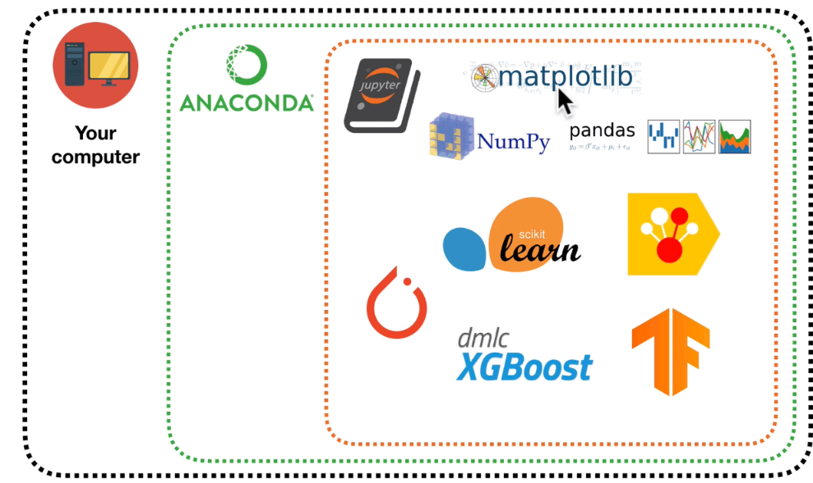

Part III - MLA
Application
Environment
  Install python
  Install Anaconda
  or
  Create Colab account
(H2)
https://jupyter.org/
https://colab.research.google.com/
(H1)
Notes:
Udemy
and
https://www.synopsys.com/ai/what-is-reinforcement-learning.html

Slide 5
Part III - MLA
Model Creation
Why Splitting Datasets?
  Huge amount of data…get it small
  Different actions for different parts of the dataset (avoid data leakage,, taining, etc)
  Avoiding possible bias…
  Get samples…get easiness!
Notes:
https://www.analyticsvidhya.com/blog/2020/10/feature-selection-techniques-in-machine-learning/

Slide 6
Part III - MLA
Modelling in ML
ML Steps (Review):
Understanding the Problem
Collect/Prepare data (ETL)
Train algorithm
Test the Algorithm
Collect feedback (evaluate)
Refine the algorithm
Loop 2-5 until the results are satisfying
Use the model to predict
See: https://www.mrdbourke.com/a-6-step-field-guide-for-building-machine-learning-projects/

Slide 7
Part III - MLA
Model Creation
dataset.sample()
Shuffling Datasets
  It is important to split the dataset avoiding creation of bias or imbalanced datasets
  The data are mixed randomly:
    Ensures that the data is randomly ordered, preventing patterns in the data sequence from influencing model training
    Randomizing the order before splitting the data, helps ensure unbiased evaluation
shuffled_ds = ds.sample(frac=1, random_state=42)
Notes:
https://www.analyticsvidhya.com/blog/2020/10/feature-selection-techniques-in-machine-learning/

Slide 8
Part III - MLA
Model Creation
Stratifying Datasets
  It is important to split the dataset avoiding losing data in resulting split sets
  Ensures that the distribution of a specific variable is preserved in both the split sets.
  When a variable (e.g., the target labels) is used in the stratify parameter during a split, the splitting process ensures that the proportion of each class in the split sets matches the proportion in the original dataset.
  Without stratification, as the split is random, can result in uneven class distributions between training and testing sets, particularly for smaller classes.
Notes:
https://www.analyticsvidhya.com/blog/2020/10/feature-selection-techniques-in-machine-learning/

Slide 9
Part III - MLA
Model Creation
Stratifying Datasets
  Crucial for maintaining class balance in split sets when the dataset is imbalanced.
  Typically applied to categorical variable (y), but it can also be used with other features (not in Regression problems)
  Ensures that the performance of models is evaluated on a test set representative of the real-world distribution of classes.
train, test = train_test_split( ds, test_size=0.2, random_state=42, stratify=ds['label']
Notes:
https://www.analyticsvidhya.com/blog/2020/10/feature-selection-techniques-in-machine-learning/

Slide 10
Part III - MLA
Model Creation
Identify the Target Feature
Splitting features (X) and target (y) separately
 | age | sex | cp | trestbps | chol | fbs | restecg | thalach | exang | oldpeak | slope | ca | thal | target
78 | 52 | 1 | 1 | 134 | 201 | 0 | 1 | 158 | 0 | 0.8 | 2 | 1 | 2 | 1
845 | 56 | 1 | 0 | 132 | 184 | 0 | 0 | 105 | 1 | 2.1 | 1 | 1 | 1 | 0
801 | 63 | 1 | 3 | 145 | 233 | 1 | 0 | 150 | 0 | 2.3 | 0 | 0 | 1 | 1
189 | 64 | 1 | 2 | 125 | 309 | 0 | 1 | 131 | 1 | 1.8 | 1 | 0 | 3 | 0
791 | 54 | 1 | 0 | 110 | 239 | 0 | 1 | 126 | 1 | 2.8 | 1 | 1 | 3 | 0
X = ds.drop(columns=‘target')
y = ds[‘target']
Notes:
https://www.analyticsvidhya.com/blog/2020/10/feature-selection-techniques-in-machine-learning/

Slide 11
Part III - MLA
Model Creation
Steps before training:
Shuffling
Stratifying
Splitting (X, y, three datatsets (train, validation, test))
Notes:
https://www.analyticsvidhya.com/blog/2020/10/feature-selection-techniques-in-machine-learning/

Slide 12
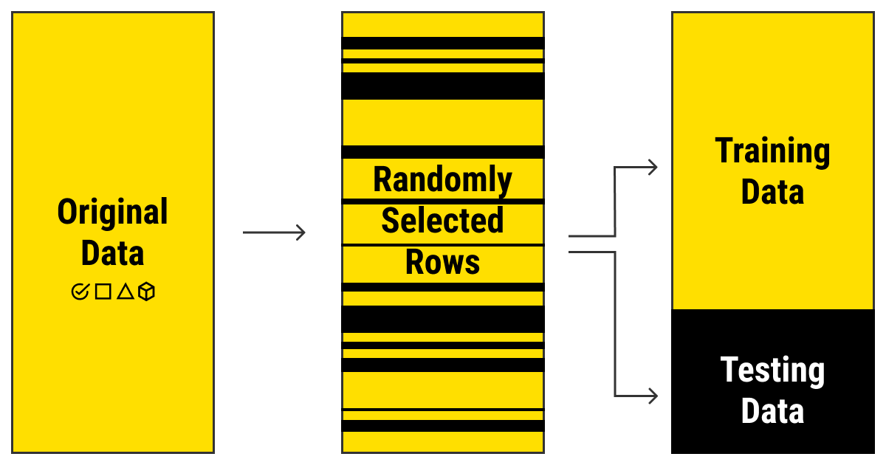
Part III - MLA
Modelling in ML
Data and Models
Dataset: data used in the modelling process
Split the full dataset in three parts:
  for Training
  for Validating (tuning)
  for Testing (test and compare)
Notes:
https://www.mrdbourke.com/a-6-step-field-guide-for-building-machine-learning-projects/

Slide 13
Part III - MLA
Modelling in ML
Data and Models
Dataset: data used in modelling process
Split dataset in three parts:
  for Training
  for Validating (tuning)
  for Testing (test and compare)
Training data is a set of samples (such as a collection of photos or videos, a set of texts or audio files, etc.) with assigned relevant and comprehensive labels (classes or tags) used to fit the parameters (weights) of a machine learning model with the goal of training it by example^{(*)}
^{(*)}https://labelyourdata.com/articles/machine-learning-and-training-data
Notes:
https://www.mrdbourke.com/a-6-step-field-guide-for-building-machine-learning-projects/

Slide 14
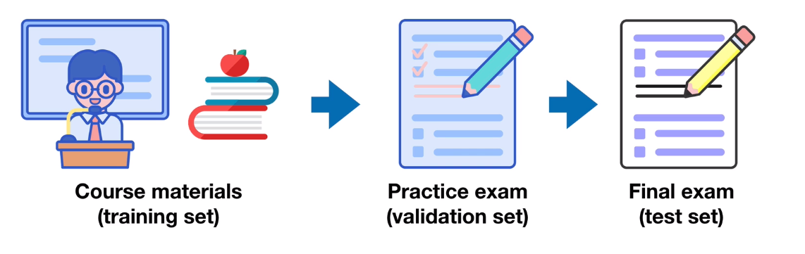
Part III - MLA
Modelling in ML
Data and Models
Dataset: data used in modelling process
Split dataset in three parts:
  for Training
  for Validating (tuning)
  for Testing (test and compare)
Model Generalization
Notes:
https://www.mrdbourke.com/a-6-step-field-guide-for-building-machine-learning-projects/
You attend and study during classes
You prove your knowledge during practices
You are confident for the final exam…the set of questions are different, but you have skills to overpass them!
Model generalization: model perform well on unknown data…on data the model hasn’t seen before
Q: what happens if the practice exam is equal to the final exam?

Slide 15
Part III - MLA
Modelling in ML
Data and Models
Dataset: data used in modelling process
Split dataset in three parts:
  for Training
  for Validating (tuning)
  for Testing (test and compare)
What happens if the practice exam is equal to the final exam?
It was only a memorization exercise!!!
Model Generalization
Notes:
https://www.mrdbourke.com/a-6-step-field-guide-for-building-machine-learning-projects/
You attend and study during classes
You prove your knowledge during practices
You are confident for the final exam…the set of questions are different, but you have skills to overpass them!
- Only top marks
- Not prepared for different questions
- Did the students really learn something?
- Or they only memorized well?
Model generalization: model perform well on unknown data…on data the model hasn’t seen before
Q: what happens if the practice exam is equal to the final exam?

Slide 16
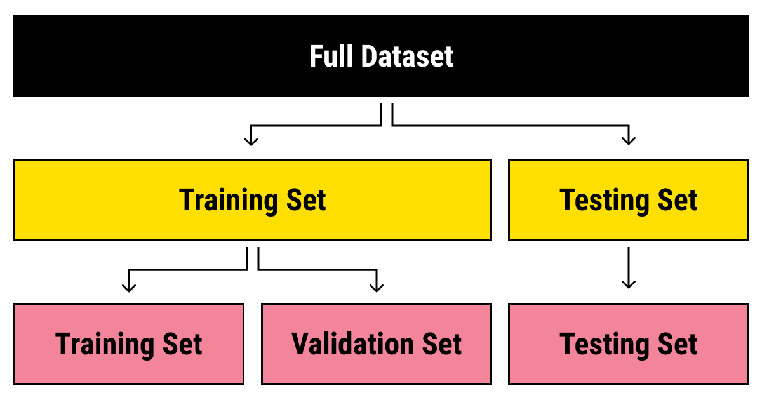
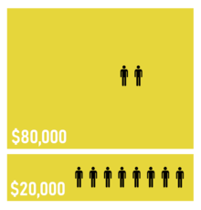
Part III - MLA
Modelling in ML
“…80% of forest fires in 2024 happened in the north, which represents 20% of the country…”
Data and Models
To learn how to perform well over unseen data
Split dataset in three parts:
  for Training 70-80%
  for Validating (tuning) 10-20%
  for Testing (test and compare) 10-20%
70:30
70:30
“Pareto principle” of 80:20 or sometimes 70:30
Notes:
https://www.mrdbourke.com/a-6-step-field-guide-for-building-machine-learning-projects/
The Pareto principle states that for many outcomes, roughly 80% of consequences come from 20% (Wikipedia)

Slide 17
Part III - MLA
Modelling in ML
Best Practices in Data Splitting
Randomization: Randomly shuffle data before splitting to avoid order-related biases.
Stratification: Maintain class distribution in each split, essential for
classification tasks
Cross-Validation: Employ k-fold cross-validation for robust model
assessment, especially in smaller datasets.
Notes:
https://www.mrdbourke.com/a-6-step-field-guide-for-building-machine-learning-projects/
The Pareto principle states that for many outcomes, roughly 80% of consequences come from 20% (Wikipedia)
You attend and study during classes
You prove your knowledge during practices
You are confident for the final exam…the set of questions are different, but you have skills to overpass them!
- Only top marks
- Not prepared for different questions
- Did the students really learn something?
- Or they only memorized well?
Model generalization: model perform well on unknown data…on data the model hasn’t seen before
Q: what happens if the practice exam is equal to the final exam?

Slide 18
Part III - MLA
Modelling in ML
Best Practices in Data Splitting
Repeat splitting with the same subsets of data. Fixing the seed for the pseudo-random number (random_state=1)
# if split again, to see the same split, set a number to random_state
X_train, X_test, y_train, y_test = train_test_split(X, y, test_size=0.33, random_state=1)
Notes:
https://www.mrdbourke.com/a-6-step-field-guide-for-building-machine-learning-projects/
The Pareto principle states that for many outcomes, roughly 80% of consequences come from 20% (Wikipedia)
You attend and study during classes
You prove your knowledge during practices
You are confident for the final exam…the set of questions are different, but you have skills to overpass them!
- Only top marks
- Not prepared for different questions
- Did the students really learn something?
- Or they only memorized well?
Model generalization: model perform well on unknown data…on data the model hasn’t seen before
Q: what happens if the practice exam is equal to the final exam?

Slide 19
Part III - MLA
Modelling in ML
Best Practices in Data Splitting
Stratification: Maintain class distribution in each split, essential for
classification tasks.
Stratification:
Some classification problems do not have a balanced number of examples for each class label
it is desirable to split the dataset into train and test sets in a way that preserves the same proportions of examples in each class as observed in the original dataset.
Notes:
https://www.mrdbourke.com/a-6-step-field-guide-for-building-machine-learning-projects/
The Pareto principle states that for many outcomes, roughly 80% of consequences come from 20% (Wikipedia)
You attend and study during classes
You prove your knowledge during practices
You are confident for the final exam…the set of questions are different, but you have skills to overpass them!
- Only top marks
- Not prepared for different questions
- Did the students really learn something?
- Or they only memorized well?
Model generalization: model perform well on unknown data…on data the model hasn’t seen before
Q: what happens if the practice exam is equal to the final exam?

Slide 20
Part III - MLA
Modelling in ML
Best Practices in Data Splitting
Stratification: Maintain class distribution in each split, essential for
classification tasks.
Stratification:
Some classification problems do not have a balanced number of examples for each class label
it is desirable to split the dataset into train and test sets in a way that preserves the same proportions of examples in each class as observed in the original dataset.
...
# split into train test sets
X_train, X_test, y_train, y_test = train_test_split(X, y, test_size=0.50, random_state=1, stratify=y)
Notes:
https://www.mrdbourke.com/a-6-step-field-guide-for-building-machine-learning-projects/
The Pareto principle states that for many outcomes, roughly 80% of consequences come from 20% (Wikipedia)
You attend and study during classes
You prove your knowledge during practices
You are confident for the final exam…the set of questions are different, but you have skills to overpass them!
- Only top marks
- Not prepared for different questions
- Did the students really learn something?
- Or they only memorized well?
Model generalization: model perform well on unknown data…on data the model hasn’t seen before
Q: what happens if the practice exam is equal to the final exam?

Slide 21
Part III - MLA
Modelling in ML
Common Mistakes to Avoid
Data Leakage: Ensure no information from the test set influences the
training or validation.
Ignoring Class Imbalance: Address class imbalances by stratifying splits for better model training
Overlooking Cross-Validation: Relying solely on a single train-test split may bias model evaluation.
Notes:
Data Leakage == Fuga de dados

Slide 22
Part III – MLA – Modell Creation
Practice
Splitting and Stratifying Dataset
  5_Model_Creation_Spliting Dataset.ipynb
Notes:
Precision k : Example: Top10 (k=10)

Slide 23
Part III - MLA
Modelling in ML
Modelling
Act of creating a ML model
Essential Steps:
  Chose and training a model
  Tuning the model
  Model comparison
Notes:
https://www.mrdbourke.com/a-6-step-field-guide-for-building-machine-learning-projects/

Slide 24
Part III: MLA
Modelling
Choose the model
  Problem and goals are different
  One model fits better than other
  No model fits all!

Slide 25
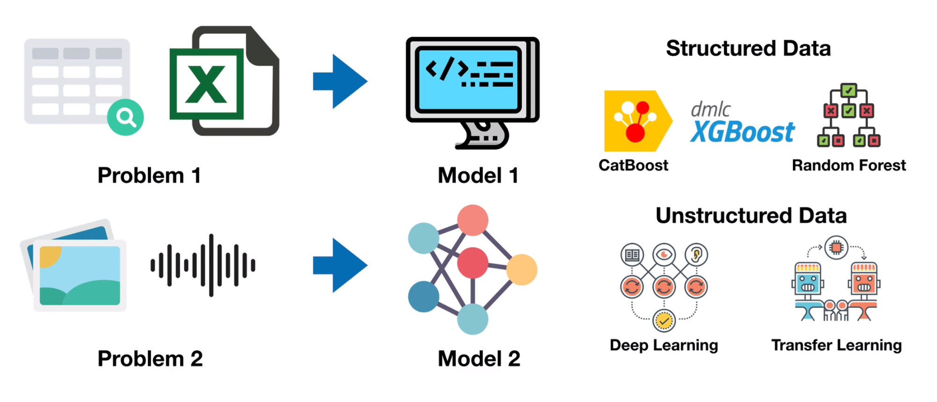
Part III: MLA
Modelling
Choose the model
  Problem and goals are different
  One model fits better than other

Slide 26
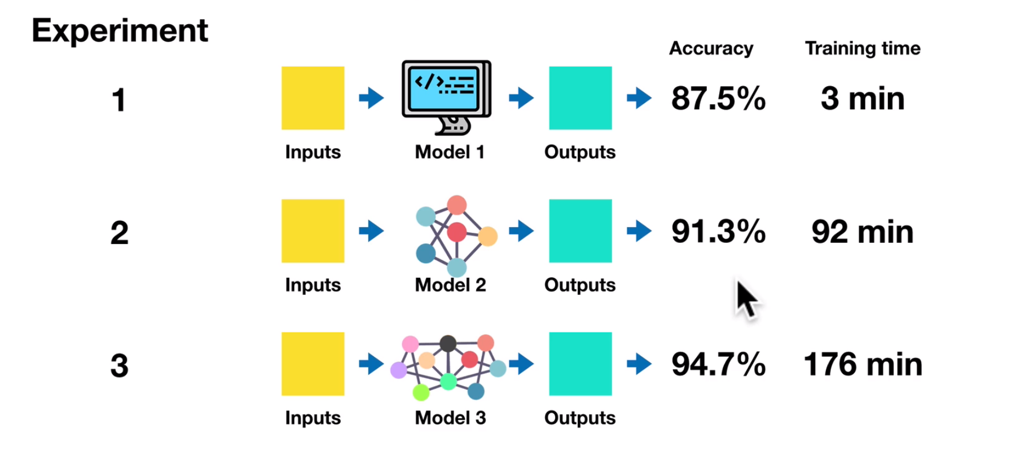
Part III: MLA
Modelling
1 - Training the model
  Prepare the Training Data (cleaning, normalizing, etc.)
  Divide the Full Dataset (training, validation, tests)
  Training (usually) take time….minimize the experiment time
    start with small training dataset, less demanding……build up (add complexity) as needed!
Some literature suggest the opposite!

Slide 27
Part III: MLA
Modelling
2- Tuning the model
  Can the initial results be improved?

Slide 28
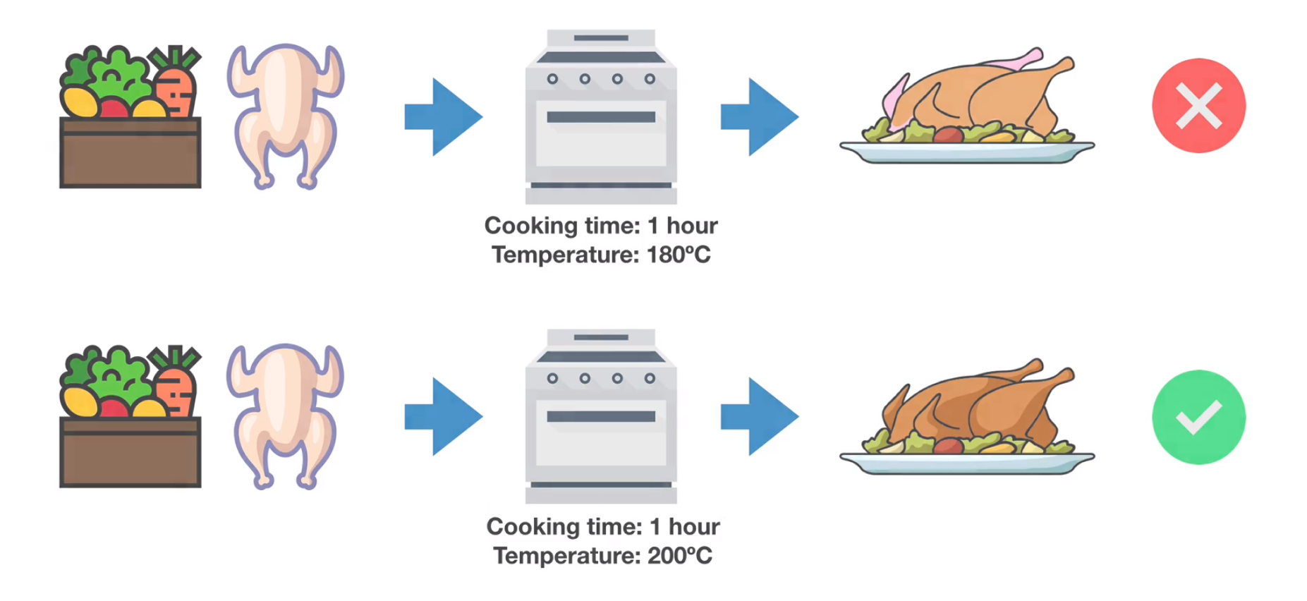
Part III: MLA
Modelling
2 - Tuning the model
  Model has initial settings
  Features == Parameters == Hyperparameters
  Settings are initial hyper-parameters' values
  If the result is not good you must adjust some hyperparameters
  Everything over Validation Data

Slide 29
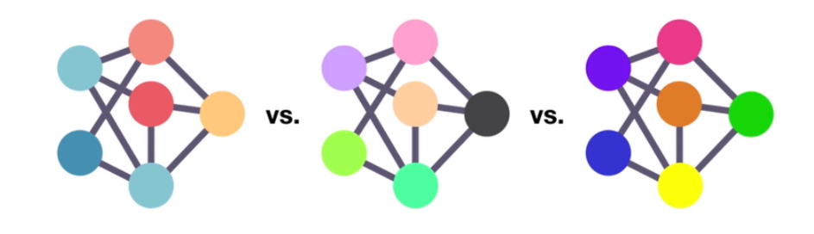
Part III: MLA
Modelling
3 - Model Comparison
  Can models be compared?
  How will our model perform in the real world?
  Time to check the model over the Test Dataset!
  Evaluate the model over Test Dataset is essential to get the Generalization!

Slide 30
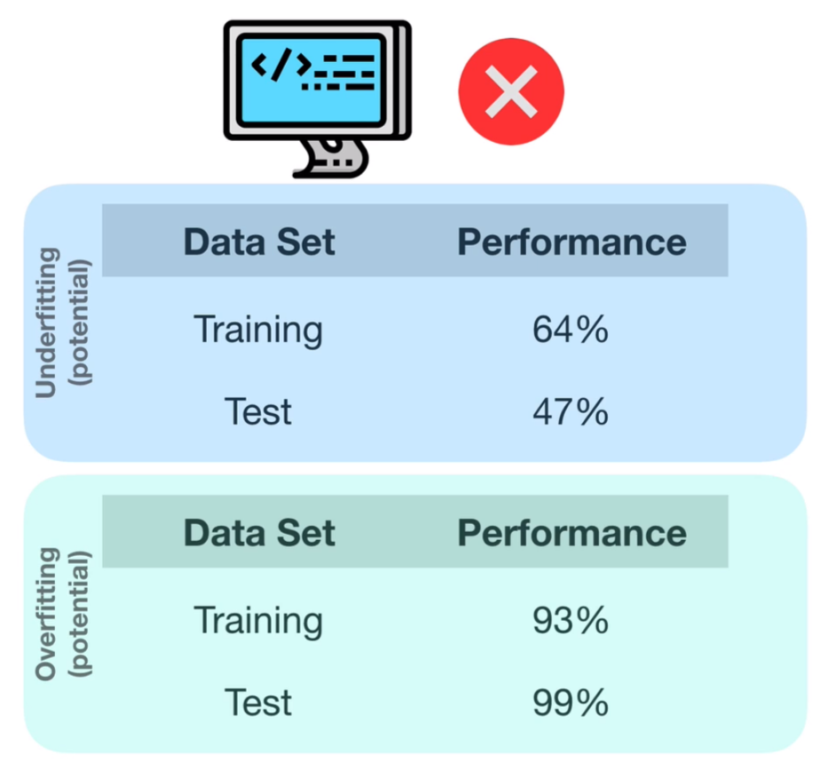
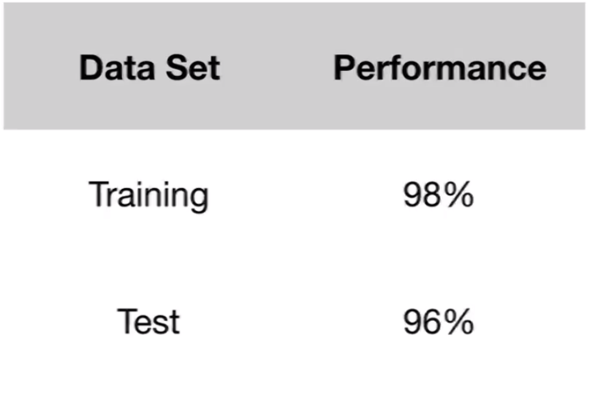
Part III: MLA
Modelling

Slide 31
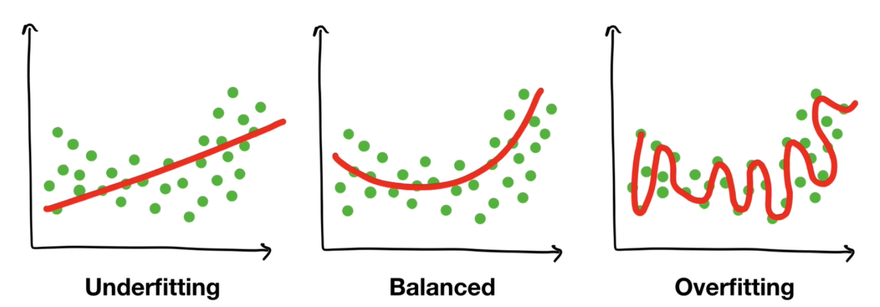
Part III: MLA
Modelling
Model Comparison
  Can models be compared?
  How will our model perform in the real world?
  Time to check the model over the Test Dataset!
  Evaluate the model over Test Dataset is essential to get the Generalization!
Notes:
Overfiting or Underfiting => not prepared to be generalized well

Slide 32
Part III: MLA
Modelling
Fixing Underfitting Performance
  Try more advanced model
  Increase model hyperparameters
  Reduce amount of features
  Train longer
Notes:
Data Mismatch == Dados diferentes

Slide 33
Part III: MLA
Modelling
Fixing Overfitting performance
  Try less advanced model
  Collect more data
Notes:
Data Mismatch == Dados diferentes

Slide 34
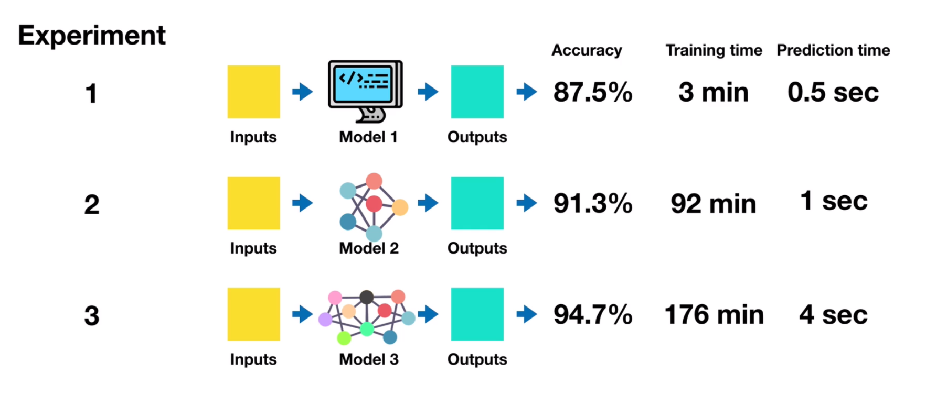
Part III: MLA
Modelling
Performance Metrics
Should it
be
compared?
Best
Prediction
time
Best
Accuracy
Notes:
Data Mismatch == Dados diferentes

Slide 35
Part III - MLA
Summary
Splitting well a Dataset is essential!
Avoid Underfitting or Overfitting
Keep the dataset test part, separated!
Compare what is comparable!
One “best performance” metric does not mean “best model”

Slide 36
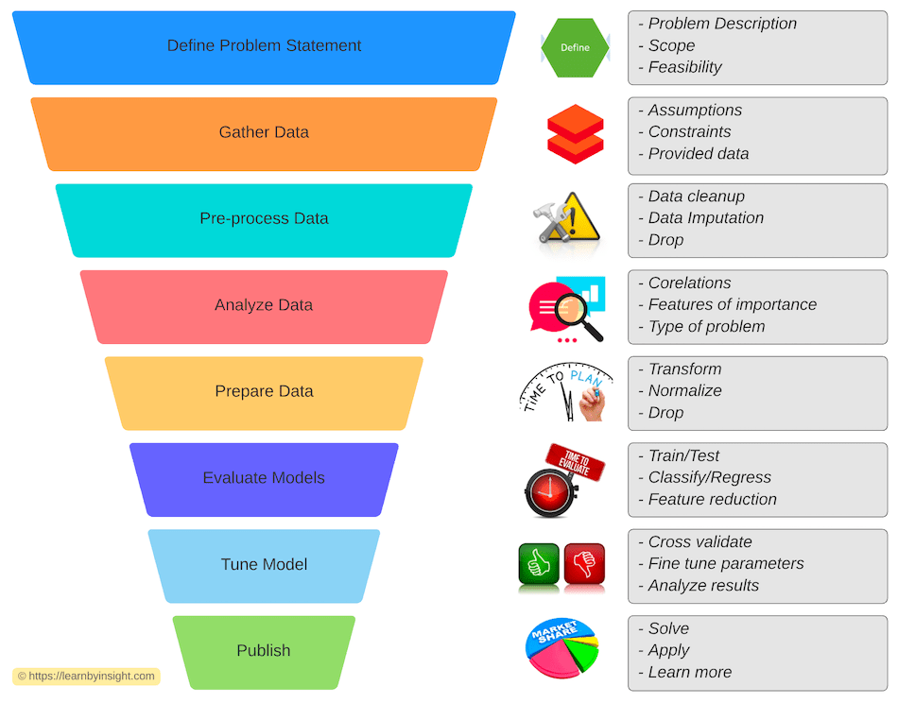
Part III - MLA
Summary
Splitting well a Dataset is essential!
Avoid Underfitting or Overfitting
Keep the dataset test part, separated!
Compare what is comparable!
One “best performance” metric does not mean “best model”

Slide 37
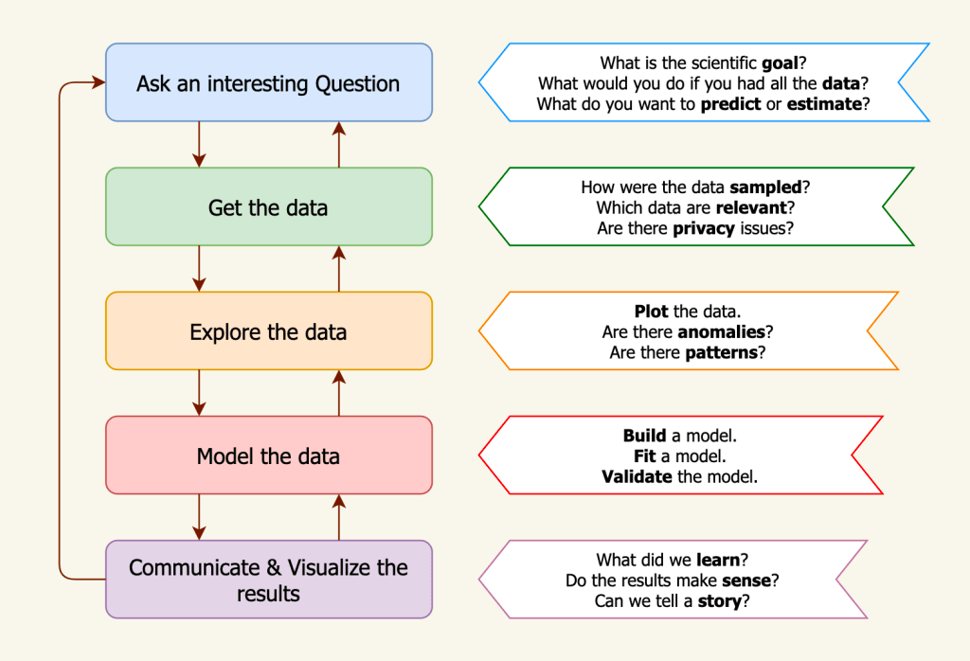
Part III - MLA
Summary
Splitting well a Dataset is essential!
Avoid Underfitting or Overfitting
Keep the dataset test part, separated!
Compare what is comparable!
One “best performance” metric does not mean “best model”
https://www.codeproject.com/articles/Quick-Look-into-Machine-Learning-Workflow#comments-section

Slide 38
Part III - MLA
Notes
To explore:
  Correlations:
    See:
      3 - MIA - MLA - III - Features Engineering- III;
      4_Data Correlation.ipynb
  Confusion Matrix (in following)

Slide 39
Progress
Part I
Artificial Intelligence and Machine Learning
Foundations
Part II
Machine Learning
Part III
Machine Learning Algorithms (I)
Part IV
Machine Learning Algorithms (I)
Part V
Advanced MLA

Slide 40
References
The Lifecycle of an AI
  https://labelyourdata.com/articles/lifecycle-of-an-ai-project-stages-breakdown#step_4_scrub_your_data_clean
Examples of Machine Learning Projects
  https://www.datacamp.com/blog/machine-learning-projects-for-all-levels
Elements of AI (free online course)
  https://www.elementsofai.com/

Slide 41
References
Google Colab
  https://colab.research.google.com/
Pandas Tutorial
  https://www.w3schools.com/python/pandas/ref_df_sample.asp

Slide 42
References
Machine Learning. Tom M. Mitchel, McGraw-Hill, 1997
Machine Learning for Everyone
  https://vas3k.com/blog/machine_learning/
Machine Learning Tutorial
  https://www.simplilearn.com/tutorials/machine-learning-tutorial/machine-learning-steps
What is machine learning and how does it work? In-depth guide
  https://www.techtarget.com/searchenterpriseai/definition/machine-learning-ML

Slide 43
Appendices

Slide 44
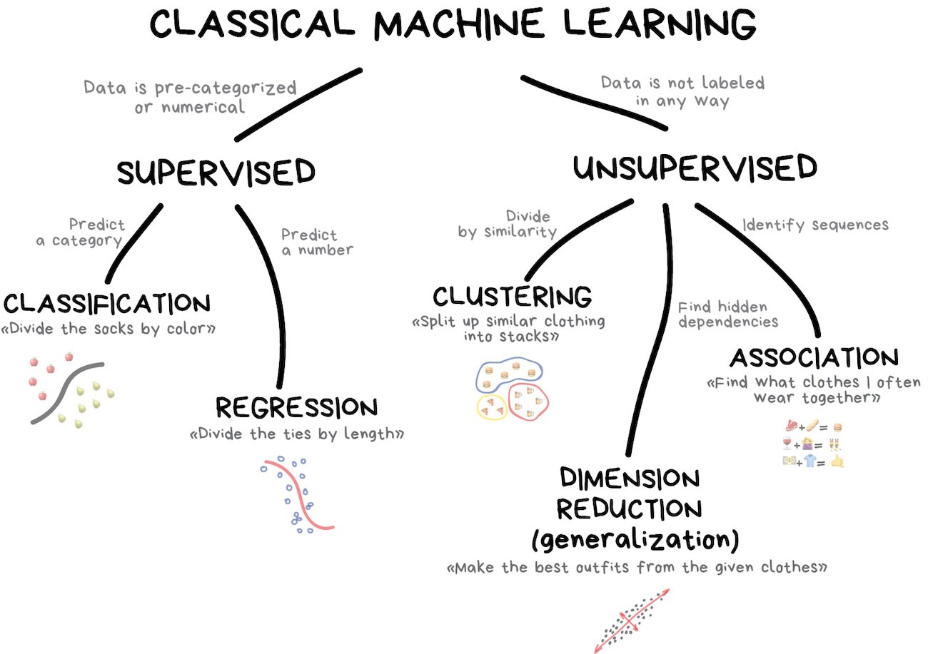
Notes:
https://vas3k.com/blog/machine_learning/

Slide 45

https://scikit-learn.org/stable/tutorial/machine_learning_map/index.html
Notes:
https://vas3k.com/blog/machine_learning/

